Slide 1
0918
John

Slide 2
(with WWL kernel calculated distance matrix)
datasets
(After clustering, now can Use cluster info. as label)
(Total:1554)
deepchem.splits.splitters.RandomSplitter(seed)
StratifiedShuffleSplit(n_splits=2, test_size=0.1, seed)
(Train: test = 9 :1)
Train-sets & test-sets
RandomOverSampler(random_state=42)
(the size of each cluster is the same)
deepchem.splits.splitters.RandomSplitter(seed).k_fold_split()
Oversampled train-set
deepchem.splits.splitters.RandomSplitter(seed).k_fold_split()
5-fold_dataset
train/ validate/ test

Slide 3
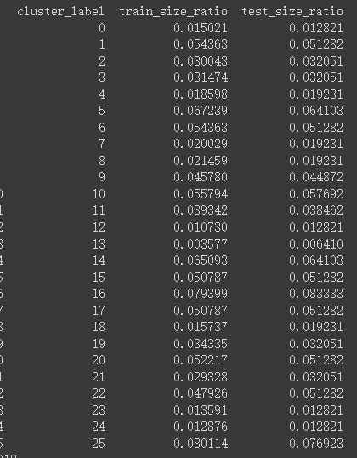
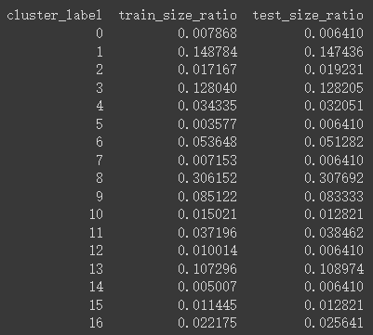
Examine StratifiedShuffleSplit
K-means
K-medoids
Oversampling To all class size= 428
Oversampling To all class size= 112

Slide 4
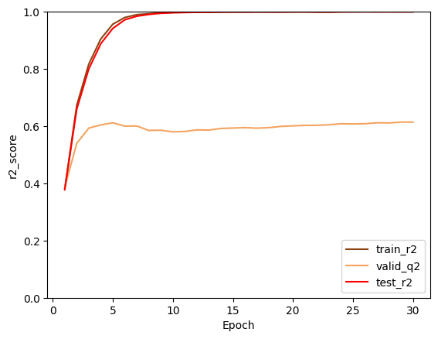
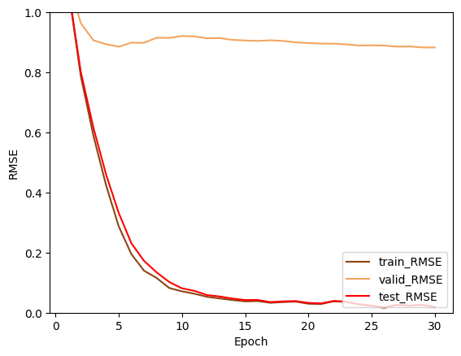
K-means clustering & oversampling
Best r2
Train: 0.9998
Valid: 0.9997
Test: 0.6141
Best rmse
Train: 0.0179
Valid: 0.0192
Test: 0.8828

Slide 5
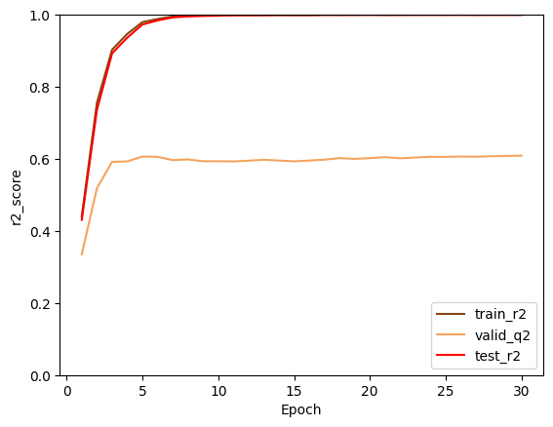
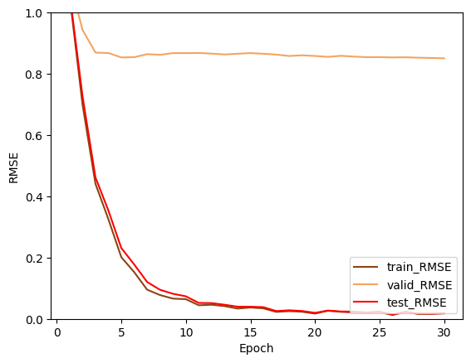
K-medoids clustering & oversampling
Best r2
Train: 0.9998
Valid: 0.9998
Test: 0.6091
Best rmse
Train: 0.0177
Valid: 0.0185
Test: 0.8505

